Slide 1

DETAILED
ANALYSIS
OF DVD
STORE
DETAILED ANALYSIS OF DVD STORE

Slide 2
TOTAL REVENUE
67406.56
INVENTORY SIZE
4581
TOTAL STORES
2
TOTAL FILM CATEGORIES
15

Slide 3
TELEGRAPH VOYAGE HAS GENERATED THE MAXIMUM REVENUE

Slide 4
PG-13 HAS MAXIMUM REVENUE SHARE

Slide 5
SPORTS CATEGORY HAS GENERATED THE MAXIMUM REVENUE

Slide 6
MAXIMUM DVDs ARE OF SPORTS CATEGORY IN BOTH THE STORES

Slide 7
INDIA HAS MAXIMUM ACTIVE CUSTOMERS

Slide 8
STORE 2 HAS HIGHER SALES

Slide 9
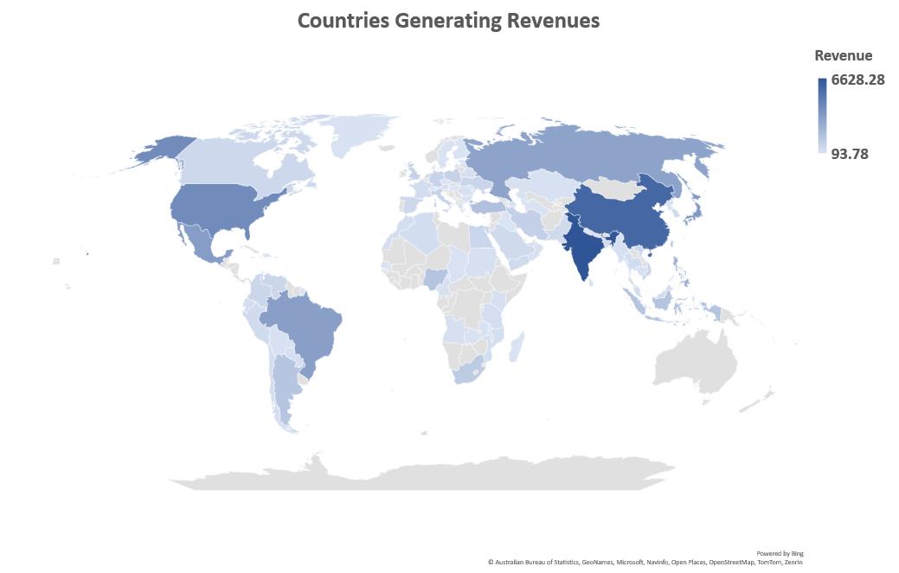
INDIA AND CHINA CONTRIBUTED MOST TO THE REVENUE

Slide 10
THANK YOU

